Slide 1




AIM: Acoustic Inertial Measurement
For Indoor Drone Localization and Tracking
Yimiao Sun¹, Weiguo Wang¹, Luca Mottola², Ruijin Wang³, Yuan He¹
¹ Tsinghua University
² Politecnico di Milano and RI.SE Sweden
³ University of Electronic Science and Technology of China

Slide 2
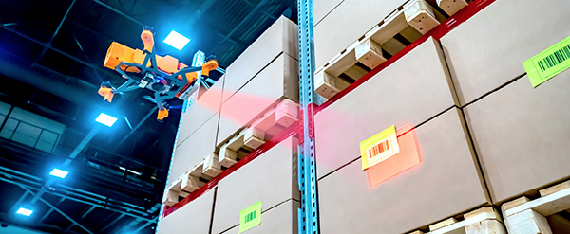


Emerging Indoor Drone Application
Inventory
Logistics
Indoor Warehouse
Surveillance

Slide 3
Dilemma of Indoor Drone Tracking
GPS-denied
Rich mutipath
Frequent NLoS
IMU-based methods
RF-based methods
Infrared-based methods
suffer from error accumu-lation due to lack of absolute coordinate.
suffer from signal distor-tion due to rich multipath on metal.
suffer from target loss due to frequent NLoS.

Slide 4
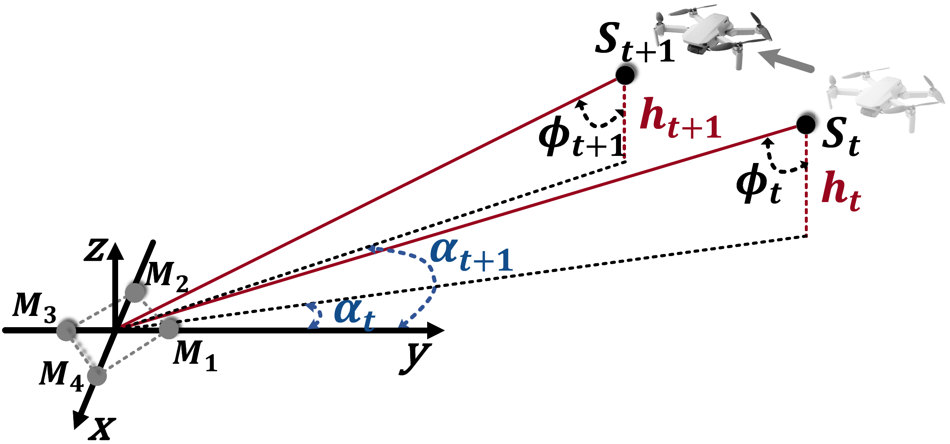
Our Method
Mean Error
1.43m in LoS
1.89m in NLoS
Error Comparison
46% less than UWB in NLoS
57% less than GPS in outdoor
An acoustics based inertial measurement working in both LoS and NLoS.

Slide 5
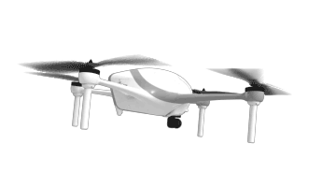
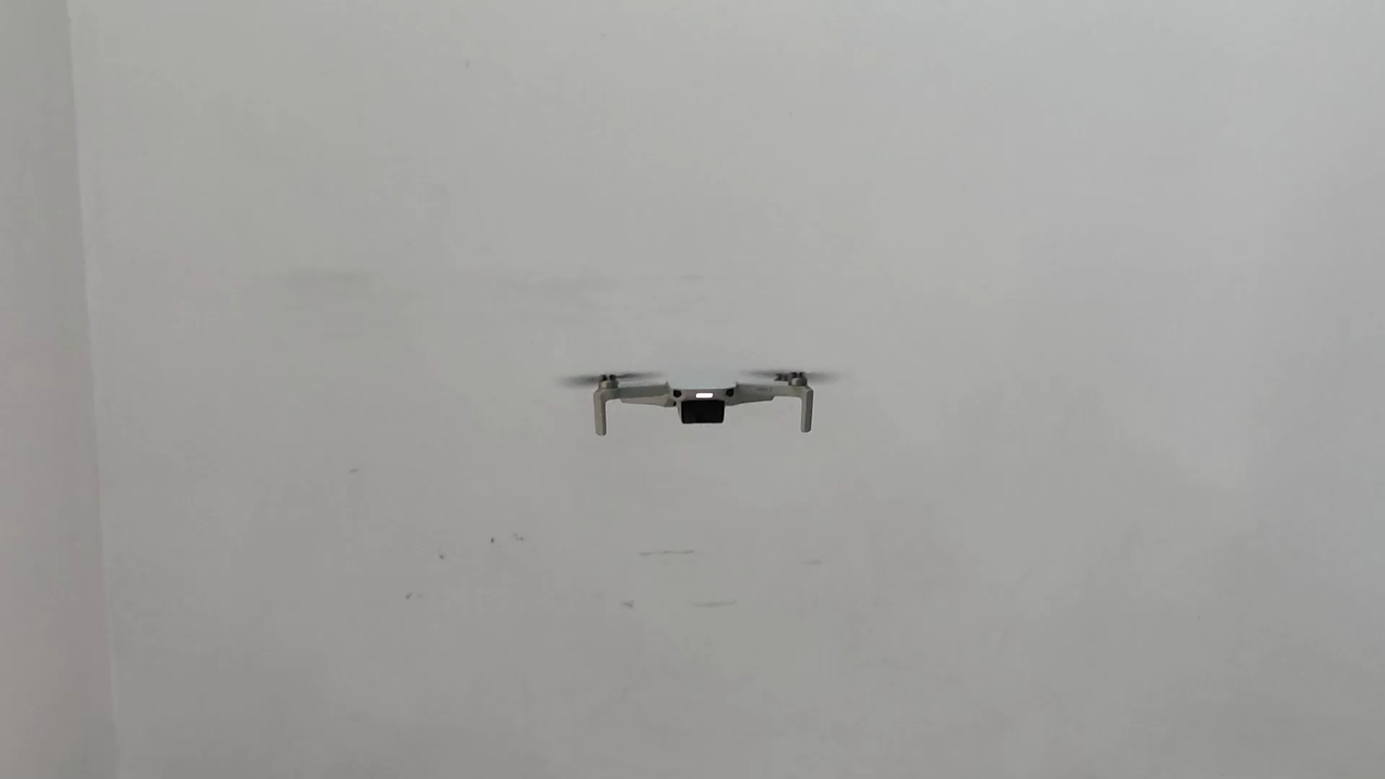
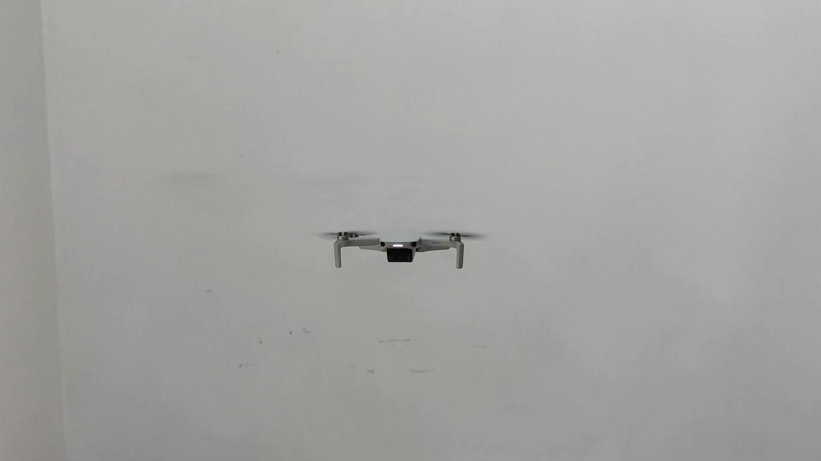
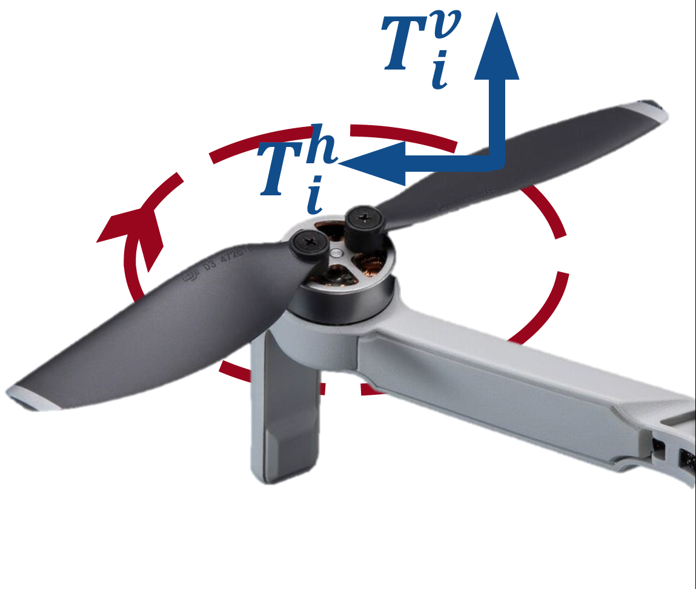
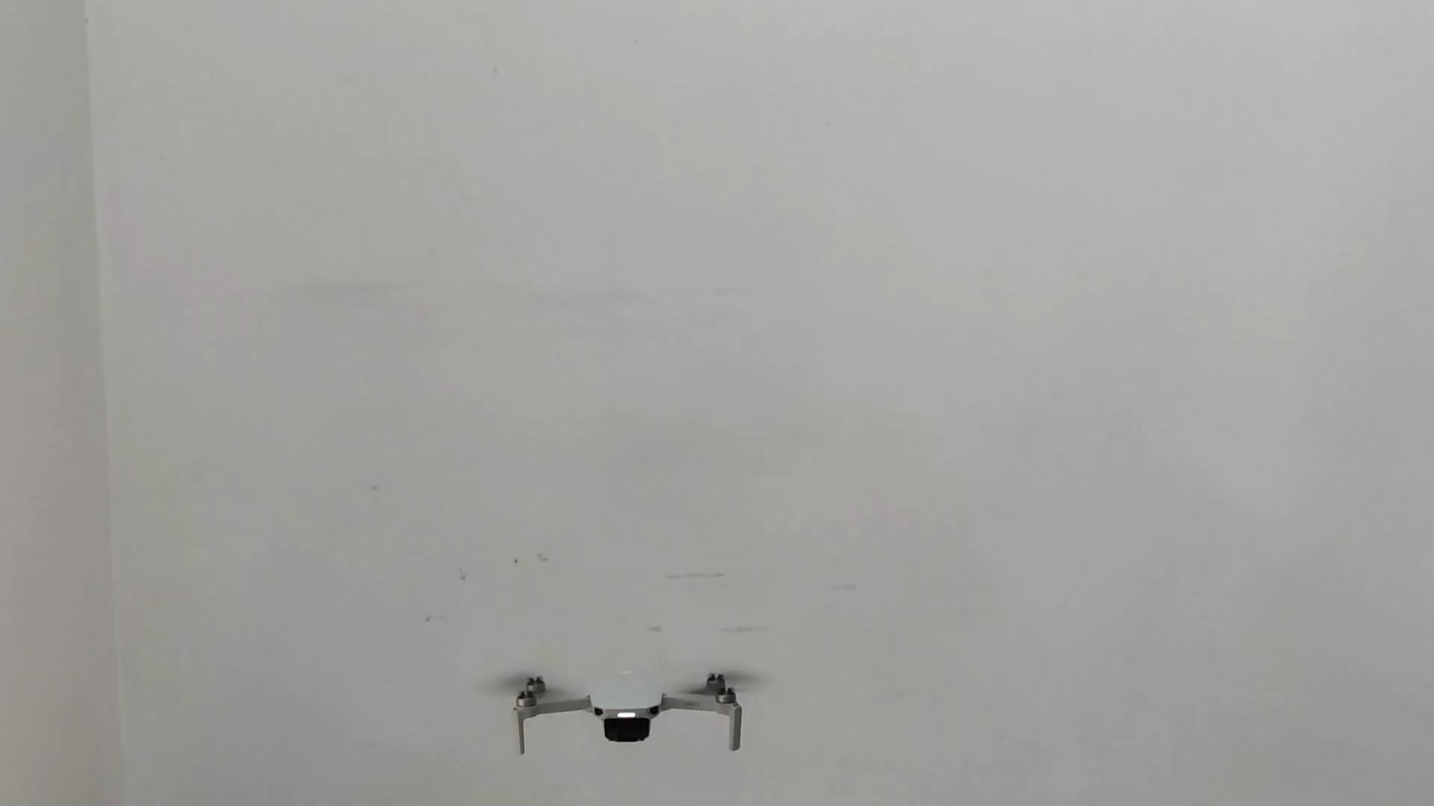

Insight
Hovering Motion
Yaw Motion
Vertical Motion
Horizontal Motion
Different motions lead to unique dynamics of propellers and fuselage.

Slide 6
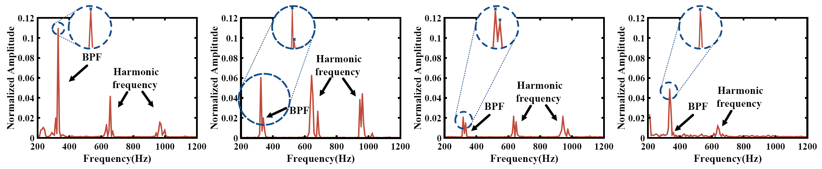
Insight
Hovering Motion
Yaw Motion
Vertical Motion
Horizontal Motion
Unique dynamics of propellers lead to distinct acoustic features

Slide 7
AIM Overview
Acoustic Inertial Measurement
with both frequency and spatial domain
Frequency domain
 | Single Peak | Multiple Peak
Unstable DoA | Vertical linear motion | Horizontal linear motion
Stable DoA | Hovering motion | Yaw motion
Spatial domain
Entirely passive scheme
Work across LoS & NLoS
Scalable to arbitrary range
No hardware modification

Slide 8
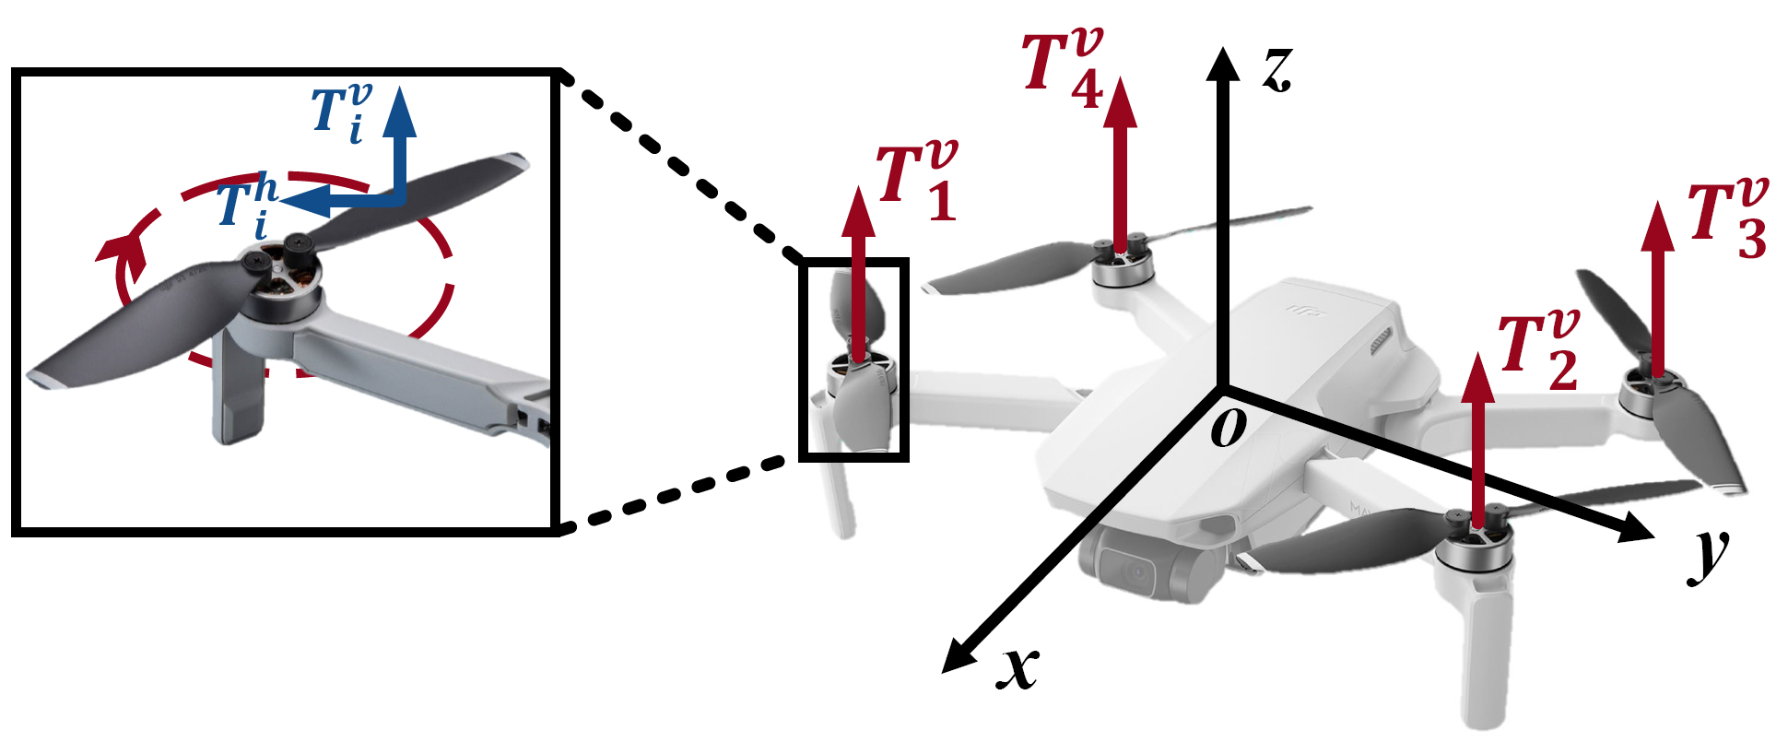
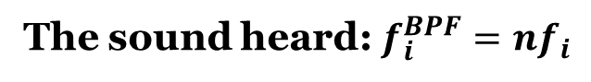
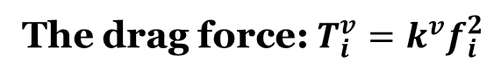
Preliminary
The drag force: $T_{i}^{v}=k^{v}f_{i}^{2}$
The sound heard: $f_{i}^{BPF}=nf_{i}$
The sound can be quantified based on drone’s structure.
Notes:
$T_{i}^{v}$: Lift force
$T_{i}^{h}$: Drag force
$k^{h}/k^{v}$: Constants
$n$: number of blades
$f_{i}$: Rotation frequency

Slide 9
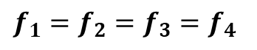
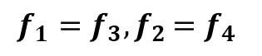
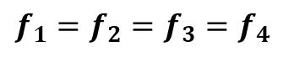
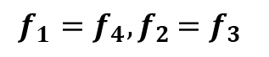
Observation
Hovering Motion
Yaw Motion
Vertical Motion
Horizontal Motion
$$f_{1}=f_{2}=f_{3}=f_{4}$$
$$f_{1}=f_{3}{, f}_{2}=f_{4}$$
$$f_{1}=f_{2}=f_{3}=f_{4}$$
$$f_{1}=f_{4}{, f}_{2}=f_{3}$$
How to disambiguate motions with the same number of frequency band?

Slide 10
Motion Identification Scheme
Disambiguate motions with information in spatial domain
Frequency domain
 | Single Peak | Multiple Peak
Unstable DoA | Vertical linear motion | Horizontal linear motion
Stable DoA | Hovering motion | Yaw motion
Spatial domain
How to find the exact coordinates ?

Slide 11
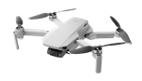
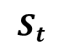


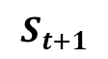


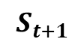
Tracking Model
$$S_{t+1}$$
$$S_{t}≠S_{t+1},h_{t}≠h_{t+1}$$
$$S_{t}$$
$$S_{t+1}$$
$$S_{t}$$
$$S_{t+1}$$
$$S_{t}≠S_{t+1},h_{t}=h_{t+1}$$
$$h_{t}$$
$$h_{t+1}$$
$$S_{t} (h_{t}\tan{φ_{t}}\cos{α_{t}},h_{t}\tan{φ_{t}}\sin{α_{t}},h_{t})$$
In both dynamic equations, the only unknown quantity is the height $h_{t+1}$
$For$ more detail, please refer to our paper.

Slide 12
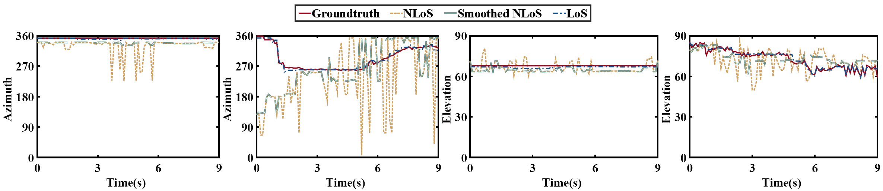
Tracking in NLoS
Stable azimuth
Unstable azimuth
Stable elevation
Unstable elevation
Smoothed NLoS azimuth always indicates whether NLoS appears.
If NLoS == True:
Enable acoustic-based inertial measurement; #Frequency domain
Else
Enable acoustic-based inertial measurement; #Frequency domain
Enable DoA-based direction calibration; #Spatial domain
Notes:
If NLoS == True:
Enable acoustic-based inertial measurement; #Frequency domain
Else
Enable acoustic-based inertial measurement; #Frequency domain
Enable DoA-based direction calibration; #Spatial domain

Slide 13
Evaluation
Playback Speed: 3x
Microphone Array
Baseline
6-Mic Array
4-Mic Array
UWB Node
Infrared Camera
DJI mini 2 Quadcopter
(Sampling rate: 48kHz)
(Fixed on the tripods)
(Weight: 249g BPF: 328Hz)
Horizontal motions:
Fly along the distance maker.
Keep vertical coordinates unchanged.
Vertical motions:
Climb or descent to a certain height.
Keeping horizontal coordinates unchanged.
Experiment area
Distance Marker
(Imaged by the drone’s camera)
Notes:
这一页的连线是否有必要

Slide 14
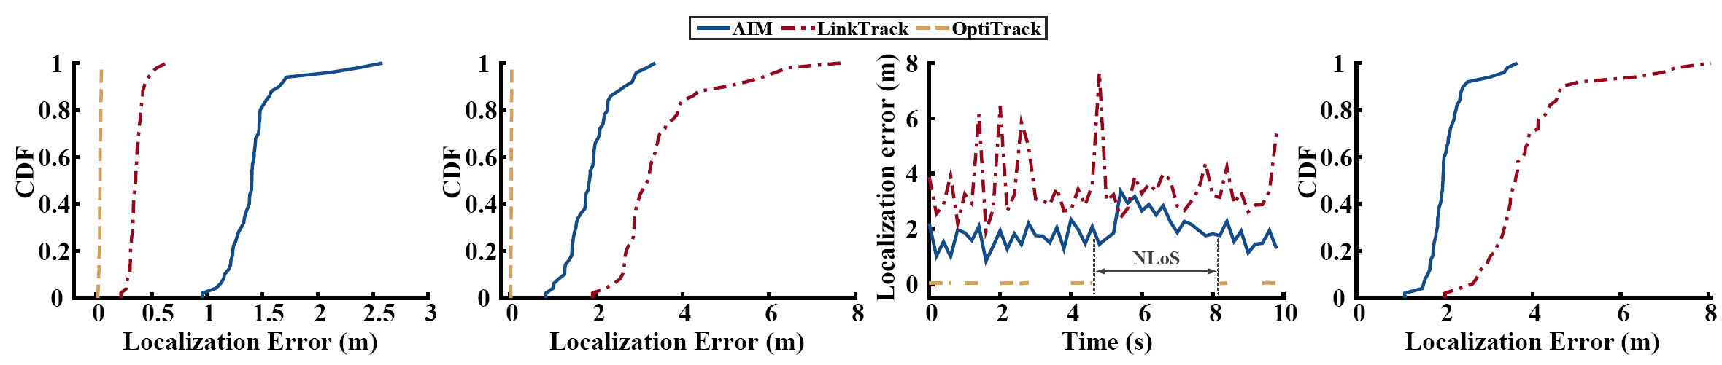
Overall Performance
LoS Scenarios
PLoS Scenarios
Variation of errors
NLoS Scenarios
AIM outperforms LinkTrack 46% in NLoS with a mean error of 1.89 m
AIM can constantly provide location updates when OptiTrack is down.

Slide 15
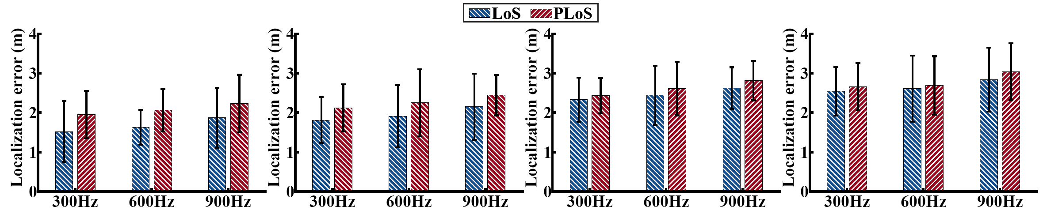
Impact of Environment Noise
50dB
55dB
60dB
65dB
AIM is robust to moderate noise sources in the environment

Slide 16
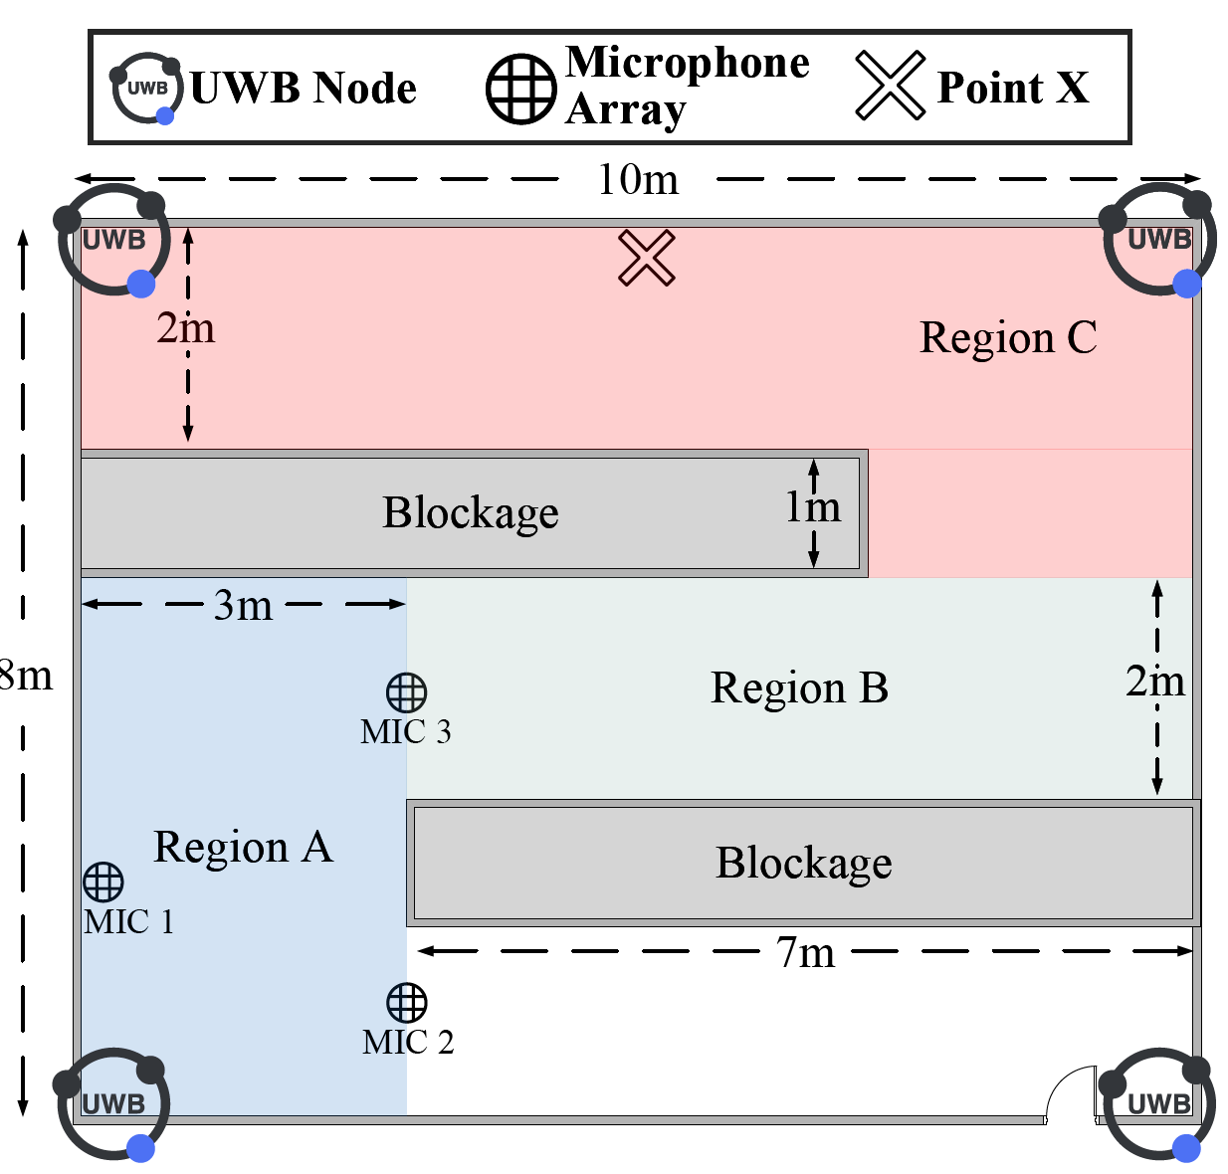
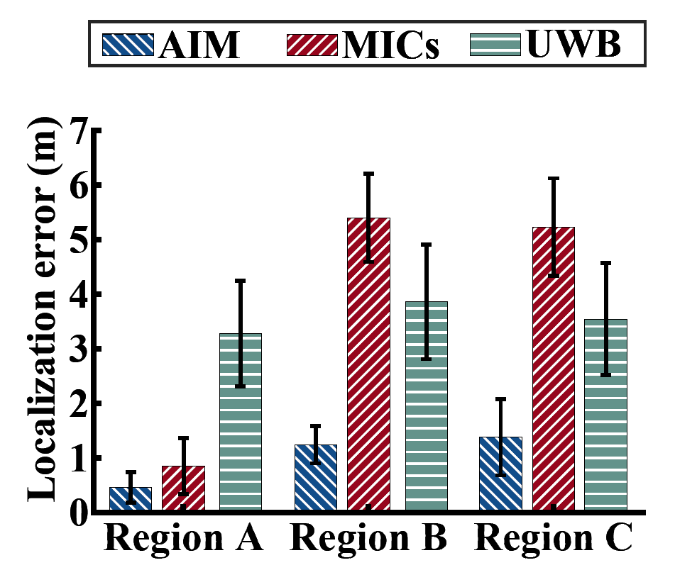
Deployment in Real Warehouse
Layout of the warehouse
Accuracy in different regions
AIM outperforms UWB in the real warehouse environment

Slide 17
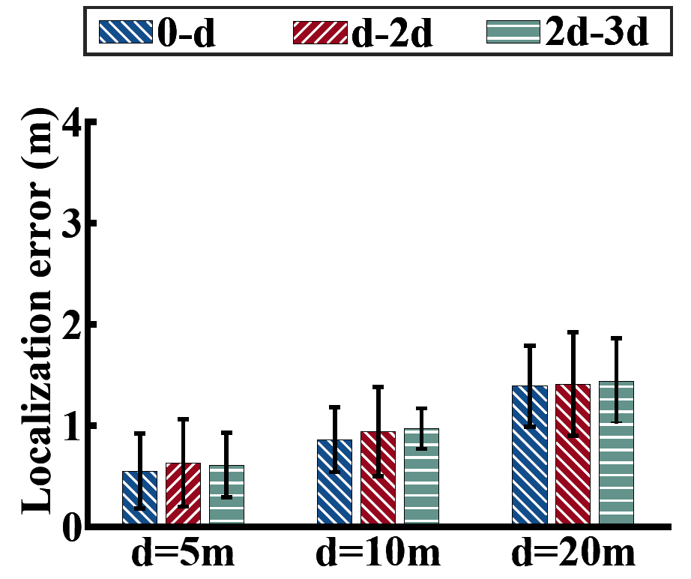
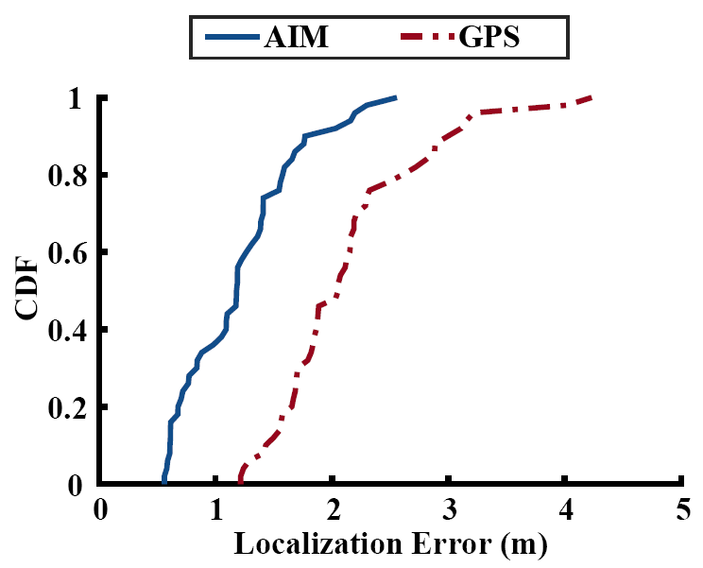
Scalability in Range and Outdoors
Accuracy at different distances
Comparison with GPS outdoors
AIM can extend to any range yet accuracy never degrades drastically.
AIM can function outdoors and outperform GPS 57 % in 2D tracking .

Slide 18
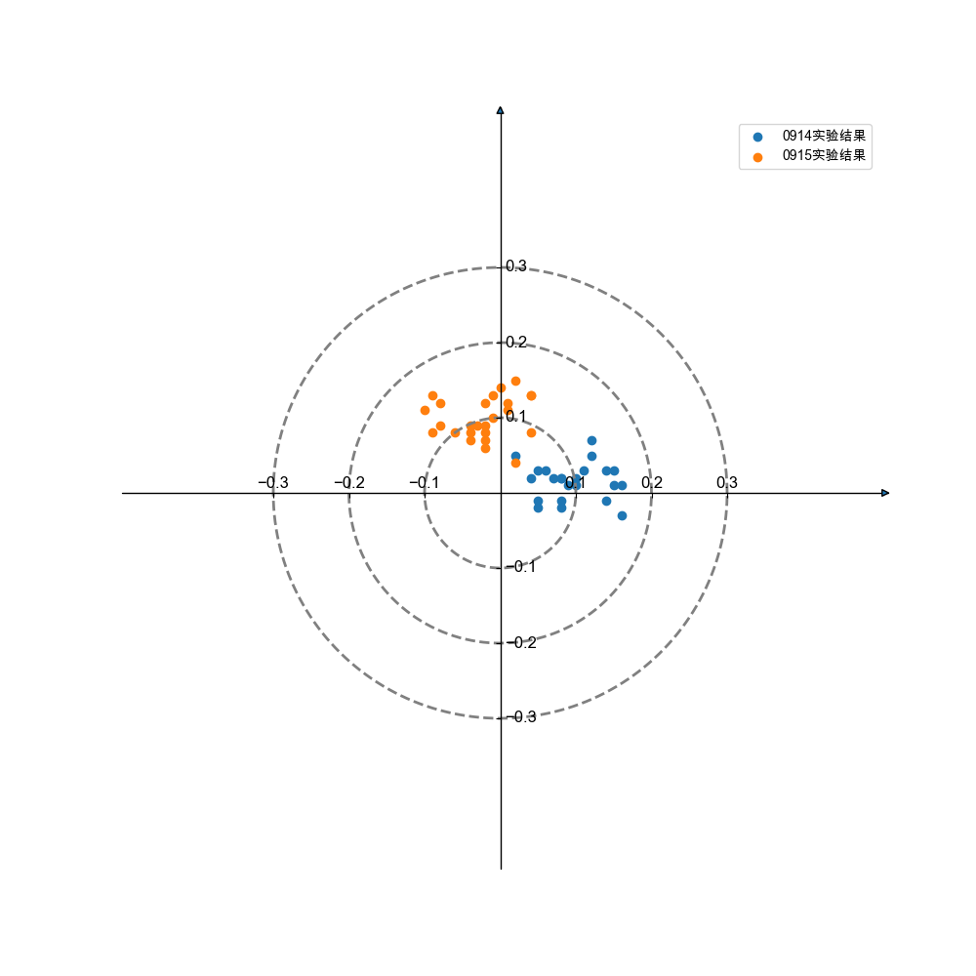
Summary
AIM is the first-of-its-kind passive indoor drone tracking technique that works with a single 2D microphone array.
The core innovation is that we explore acoustics-based dynamics, which bridges the drone’s dynamics equations and acoustic features.
AIM is able to localize a drone in any range and layout, with the mean errors 46% less than UWB indoors and 57% less than GPS outdoors.

Slide 19
Thank You!
19
19

Slide 20





Thank You!
Yimiao Sun
Weiguo Wang
Luca Mottola
Ruijin Wang
Yuan He
20
20

